Slide 1
Hello Everyone My Project Name : Box Shooter Game Course Code : CSE178
Project Supervisor:
MD Nesarul Hoque
Assistant Professor
Department of CSE,BSMRSTU
Gopalganj-8100.
Submitted By:
Tushar Sarkar
Student ID: 18CSE035
Department of CSE,BSMRSTU
Gopalganj-8100.

Slide 2
Presentation Outline
Introduction
The process to play the Box Shooter game
Features
Some Snapshots
Results & Evualations
Future Plan
Conclusion

Slide 3
Introduction
A box shooter is a game which can also be called a mind sport where in the players , either as individuals or in teams attempt to answer question.
A box shooter is an entertainment in which the general or specific knowledge of the players is tested by a series of questions as like as radio or television program or mobile & pc game.

Slide 4
The process to play the Box Shooter Game
You will first be given a frame in the shape of a quadrangle with 50 boxes at the top and a stage and a ball at the bottom.
Now clicking on space will start the game, clicking on the left key of the special keyboard will move 10 space to the left and will continue to move 90 degrees and hit the box. If you can eat one box, it will be 5 marks.
The game will end when the ball goes off the stage.
If you can finish the whole game you will be successful and you will be congratulated.

Slide 5
Features
The frame for this game will be 1200 * 675 in size.
The 50 boxes at the top will each be 100 * 20 in size.
The stage below will be 200 * 10 in size.
The radius of the ball on the stage will be 10.
The song will play in the background as soon as the game starts. Songs can be started and stopped at will.
There are 5 pictures set in the background of the frame, you can change the picture as you wish.
If you play, you will be notified of the current score and signal and if you finish the game, you will be congratulated and the signal will be there.

Slide 6
Some Snapshots
iGraphics Function
Main Function
First Look of Program
First Look when Program Run
While the game is going on
While the game is loss
When all the boxes have been eaten and success

Slide 7
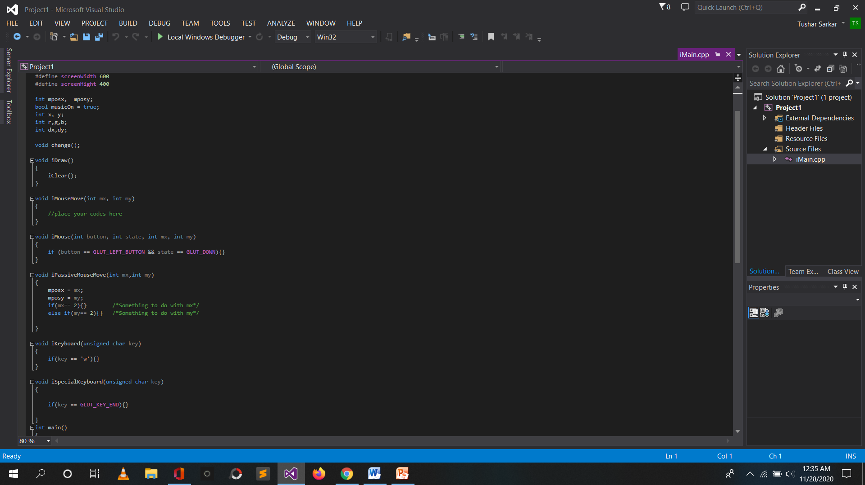
iGraphics File

Slide 8
Graphics function work
void iDraw(){
iClear();
// function iDraw() is called again and again by the system & drawing codes here
}
void iMouseMove(int mx, int my){
//function iMouseMove() is called when the user presses and drags the mouse.(mx, my) is the
Position where the mouse pointer is.
}
void iPassiveMouseMove(int mx,int my){
//iPassiveMouseMove is called to detect and use the mouse point without pressing any button
}
void iKeyboard(unsigned char key){
//function iKeyboard() is called whenever the user hits a key in keyboard.key- holds the ASCII
or special keyboard value of the key pressed.
}

Slide 9
Main Function & Work
int main()
{
//place your own initialization codes here.
iInitialize(x,y, "demooo");
return 0;
}
The main () function as a built-in function.
The compilers of most of the programming languages are so designed that the main () function constitutes the entry point of the program execution.
The main () function provides a platform for calling the first user-defined function in the program.

Slide 10
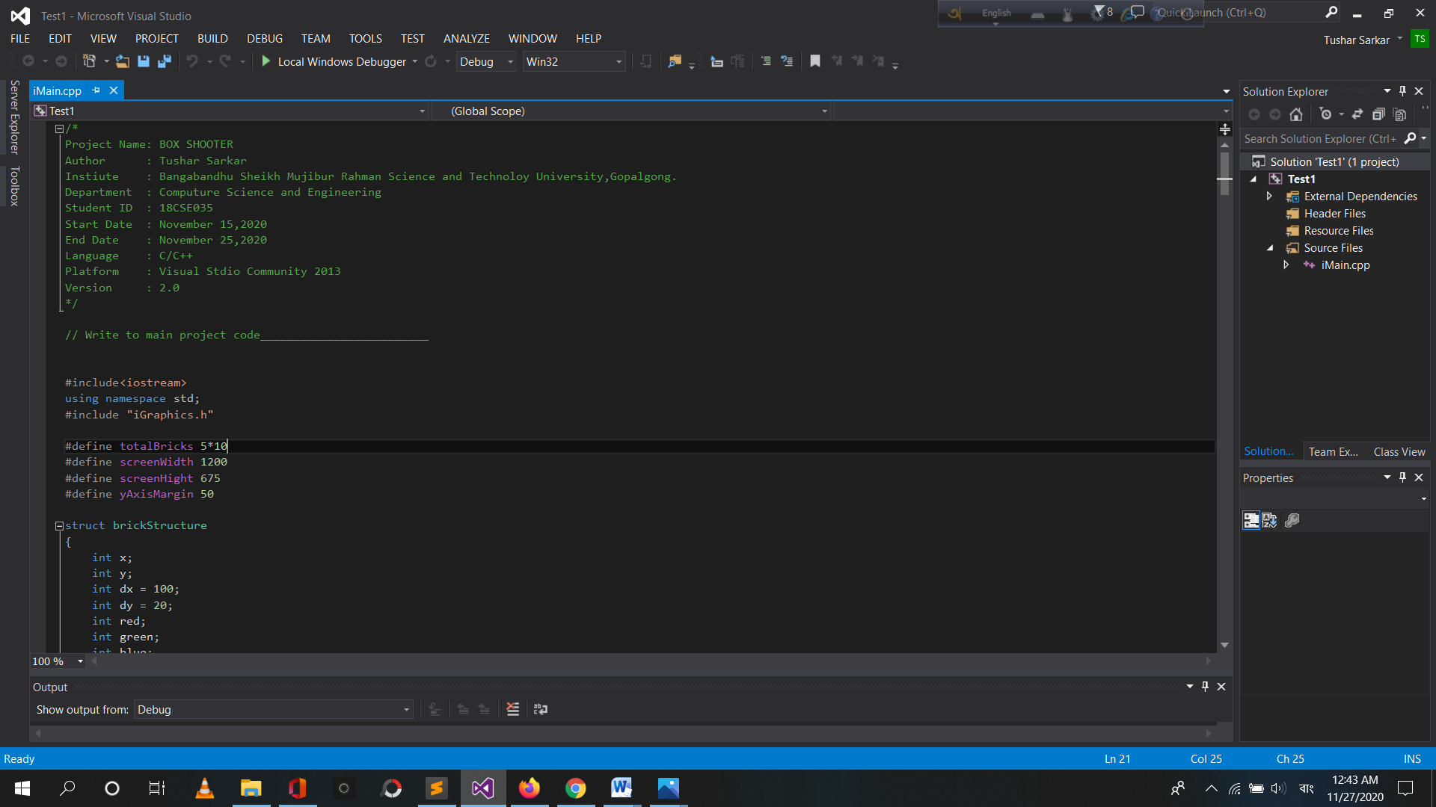
First Look of Program

Slide 11
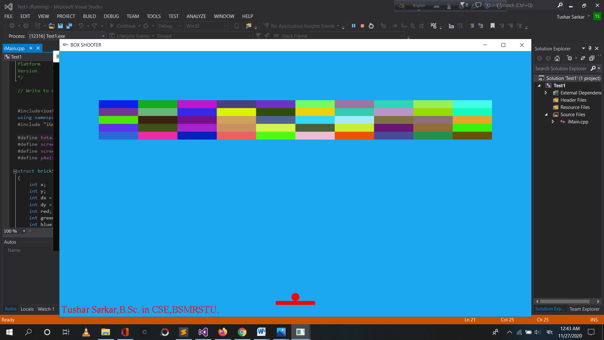
First Look when Program Run

Slide 12
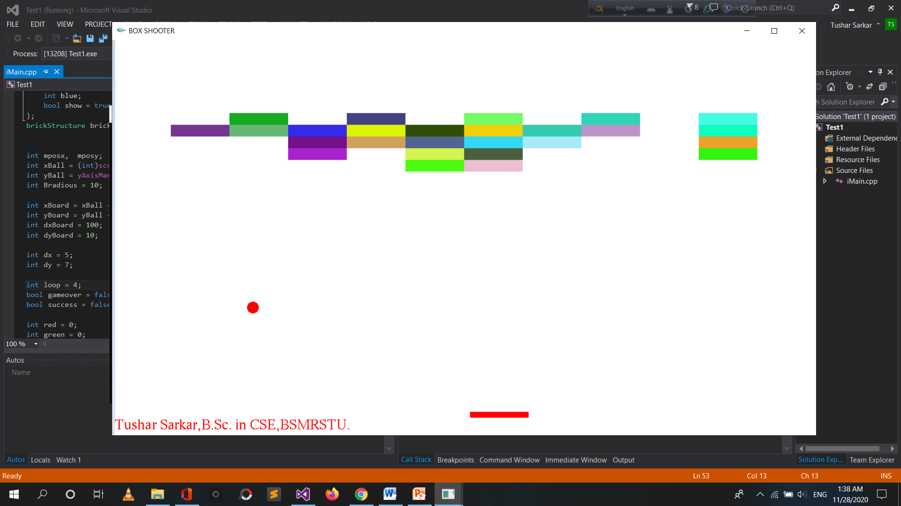
While the game is going on

Slide 13
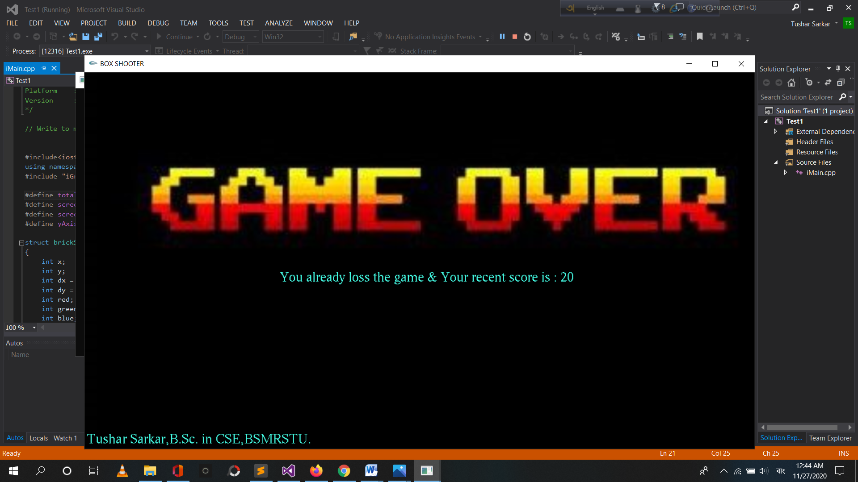
While the game is loss

Slide 14
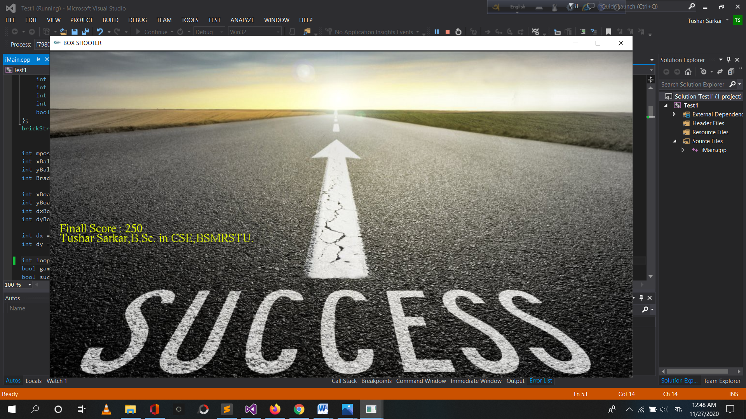
When all the boxes have been eaten and success

Slide 15
Future Plan
Now only those who have a programming platform and have added iGraphics can play with PC.
It needs to be made more workable in the form of applications and there is a desire to create separate versions for mobile and PC and that will be.
If you work harder, you will have to upload it to the Play Store separately for Windows, Linux, Mac.
Then let's eat and in the inner workings: now there are only 50 boxes in the game and if you can eat them all, then the game is over, that is, there is only one level and the time is always the same.
But later, when one level is finished at different times, boxes of different sizes will come and reducing the time means that the game will be different level wise.

Slide 16
Results & Evualations
The functional requirements that the student developed turn, almost immediately, into a checklist that can be handed to another student. Let's look at an example. The first thing we want to do is to make sure that we can draw at least one ball and see it fall on the screen. So our testing for correct function will be:
Can I display the ball?
Does it move towards the bottom of the screen?
Does it appear to speed up?
What happens when it hits the bottom?

Slide 17
Conclusion
It may seem hard to understand at first
You're working on more complex animations you can always go back to what you learned on your ball bounce exercise to get you out of a road block you've hit.
For instance, a walk cycle is actually prime place to use the ball bounce to help you work through it.
The hips should move basically the exact same way that a ball bounces on the ground, of course, it's not as exaggerated but you're essentially trying to capture the exact same pattern that a ball travels.

Slide 18
Thank You Everyone

